Slide 1
Beverage Sales Performance Dashboard
Analysis of sales across products, regions, and categories
Name : Joel Olusanya
Tools: Power Bi , Excel

Slide 2
Project Overview
This project analyzes beverage sales data to uncover insights into revenue, product performance, and regional trends using Power BI.

Slide 3
Objective
Analyze total revenue and sales performance
Identify top-performing products
Evaluate sales by region
Understand the impact of discounts

Slide 4
Dataset Description
The dataset contains:
Order transactions
Customer information
Product details
Sales metrics (Quantity, Price, Discount, Total Price)

Slide 5
Data Modelling
A star schema was created to improve performance and analysis:
FactSales (transaction data)
DimCustomer (customer details)
DimProduct (product details)

Slide 6
Key Measures
A star schema was created to improve performance and analysis:
FactSales (transaction data)
DimCustomer (customer details)
DimProduct (product details)

Slide 7
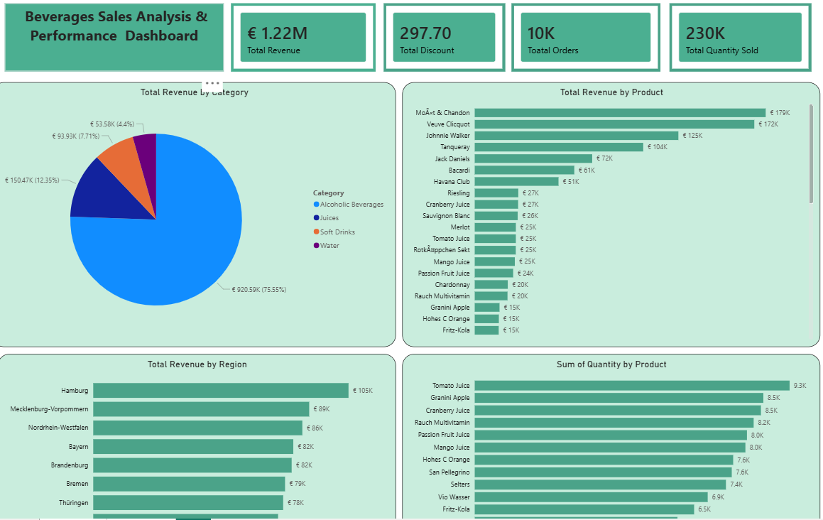
Dashboard Overview
The dashboard provides insights into:
Revenue trends
Product performance
Regional sales distribution

Slide 8
Key Insights
Soft Drinks generated the highest revenue
Water products had the highest sales volume
The South region recorded the highest revenue
Discounts reduced overall profit margins

Slide 9
Recommendation
• Focus marketing on high-performing products
• Reduce excessive discounting
• Expand sales strategies in top-performing regions

Slide 10
Conclusion
The analysis provides valuable insights into sales performance and can support better business decision-making.

